Slide 1
DataShop
Import Workshop
http://pslcdatashop.org
Tuesday, June 14, 2011
PSLC DataShop
datashop-help@lists.andrew.cmu.edu
pslcdatashop.org

Slide 2
Today’s Schedule
09:30 - 10:00 DataShop Overview
10:00 - 10:30 The DataShop Data Model
10:30 - 10:45 Break
10:45 - 11:45 Importing into DataShop
11:45 - 12:00 Exporting from DataShop
12:00 - 12:30 Case Study – Phil Pavlik
12:30 - 13:30 Q&A – Lunch
PSLC DataShop
datashop-help@lists.andrew.cmu.edu
pslcdatashop.org

Slide 3
The DataShop Team
John Stamper - DataShop Technical Director
Alida Skogsholm - DataShop Manager, Developer
Brett Leber - Interaction Designer
Duncan Spencer - DataShop Developer
Shanwen Yu - DataShop Developer
Sandy Demi - QA (Quality Assurance – Testing)
Ken Koedinger - PSLC Director
Jo Bodnar – PSLC Admin
PSLC DataShop
datashop-help@lists.andrew.cmu.edu
pslcdatashop.org

Slide 4
What is DataShop?
Central Repository
  Secure place to store & access research data
    Every LearnLab and every study
  Supports various kinds of research
    Primary analysis of study data
    Exploratory analysis of course data
    Secondary analysis of any data set
Analysis & Reporting Tools
  Focus on student-tutor interaction data
  Learning curves & error reports provide summary and low-level views of student performance
  Performance Profiler aggregates across various levels of granularity (problem, dataset levels, knowledge components, etc.)
  Data Export
    Tab delimited tables you can open with your favorite spreadsheet program or statistical package
  New tools created to meet highest demands
PSLC DataShop
datashop-help@lists.andrew.cmu.edu
pslcdatashop.org

Slide 5
Repository
PSLC DataShop
datashop-help@lists.andrew.cmu.edu
pslcdatashop.org

Slide 6
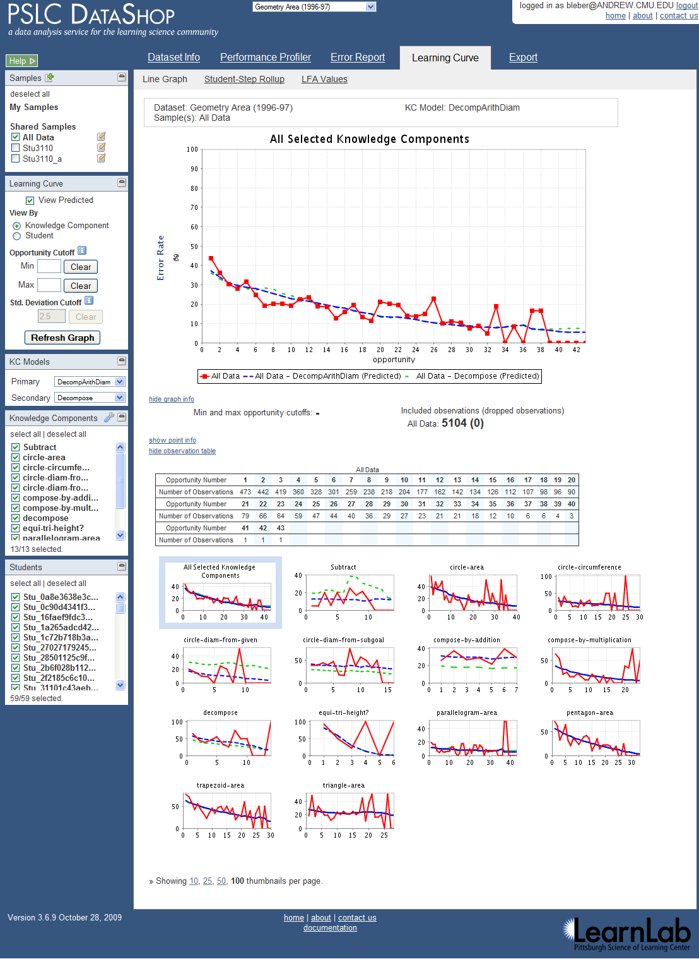
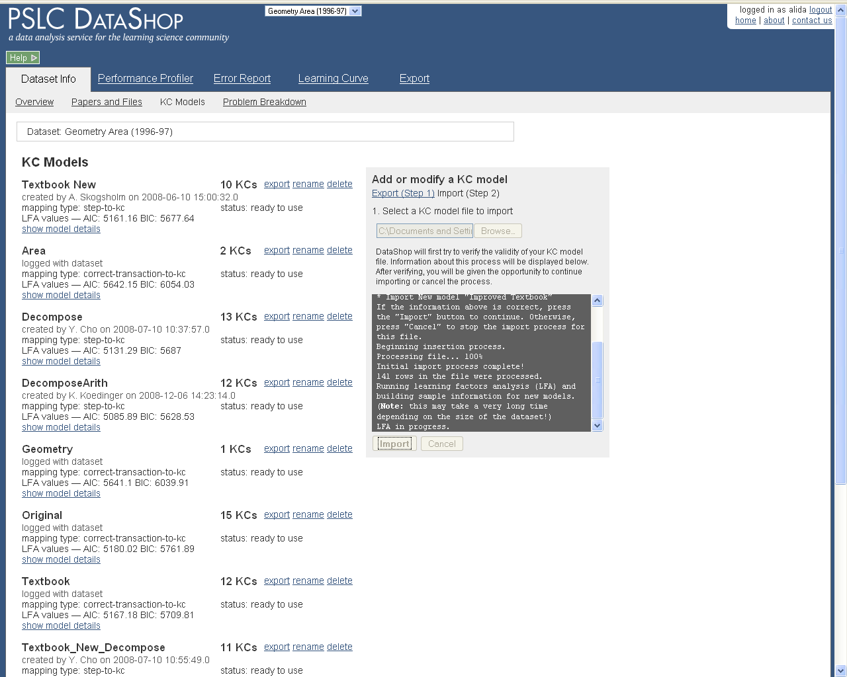
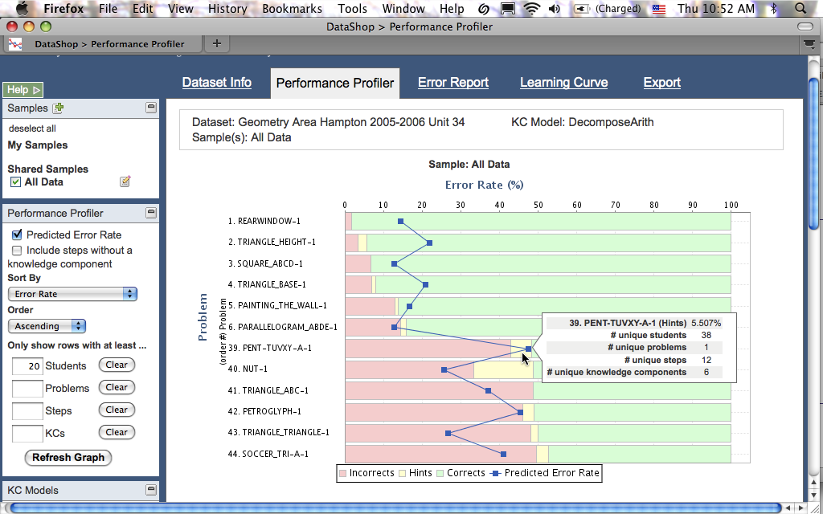
Web Application
PSLC DataShop
datashop-help@lists.andrew.cmu.edu
pslcdatashop.org

Slide 7
DataShop, what’s in it for me?
Free tools to analyze your data
Free researchers to analyze your data
Place to collaborate
Real opportunities to validate ideas across multiple data sets
PSLC DataShop
datashop-help@lists.andrew.cmu.edu
pslcdatashop.org

Slide 8
Let us know what you need!
  Feature Request wiki is available here:
  http://www.learnlab.org/research/wiki/index.php/DataShop_Feature_Wish_List
PSLC DataShop
datashop-help@lists.andrew.cmu.edu
pslcdatashop.org

Slide 9
Please fill out our survey!
http://snipr.com/workshopsurvey
PSLC DataShop
datashop-help@lists.andrew.cmu.edu
pslcdatashop.org

Slide 10
Enjoy!
http://pslcdatashop.org
datashop-help@lists.andrew.cmu.edu
PSLC DataShop
datashop-help@lists.andrew.cmu.edu
pslcdatashop.org

Slide 11
THE DATA MODEL
PSLC DataShop
datashop-help@lists.andrew.cmu.edu
pslcdatashop.org

Slide 12
DataShop Terminology
Problem: a task for a student to perform that typically involves multiple steps
Step: an observable part of the solution to a problem
Transaction: an interaction between the student and the tutoring system.
PSLC DataShop
datashop-help@lists.andrew.cmu.edu
pslcdatashop.org

Slide 13
DataShop Terminology
KC: Knowledge component
  also known as a skill/concept/fact
  a piece of information that can be used to accomplish tasks
KC Model:
  also known as a cognitive model or skill model
  a mapping between correct steps and knowledge components
PSLC DataShop
datashop-help@lists.andrew.cmu.edu
pslcdatashop.org

Slide 14
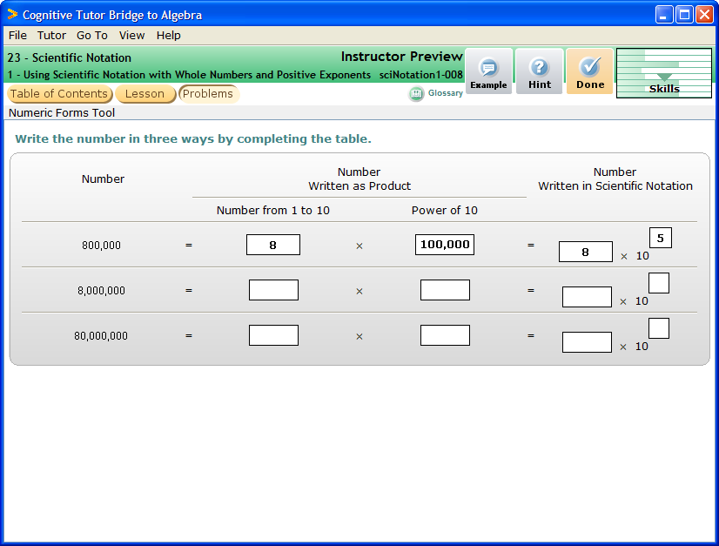
Base1 | 6
Base2
Base3
ExpandedPower1 | 100,000,000
ExpandedPower2
ExpandedPower3
Exponent1 | 8
Exponent2
Exponent3
GeneralHelpGoalNode
Multiplier1 | 6
Multiplier2
Multiplier3
Notes:
Complete UI

Slide 15
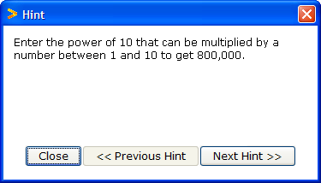
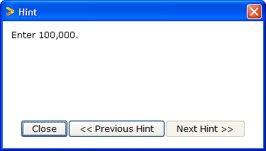
Multiplier
ExpandedPower
Base
Exponent
6
8
100,000
5
10,000
8
Exponent1
Multiplier1
ExpandedPower1
Base1
Multiplier2
ExpandedPower2
Base2
Exponent2
Multiplier3
ExpandedPower3
Base3
Exponent3
Transactions
Student-Steps
Enter 8 in Multiplier1
Multiplier1
Observation
Ask for hint on next step
Enter 10,000 in ExpandedPower1
ExpandedPower1
Ask for hint
Enter 100,000 in ExpandedPower1
Enter 8 in Base1
Base1
Observation
Enter 6 in Exponent1
Exponent1
Enter 5 in Exponent1
Notes:
English version. When a transaction appears, it’s an attempt.
When the group of transactions appears, this is toward a step. The group is considered an “observation”.

Slide 16
Multiplier
ExpandedPower
Base
Exponent
6
8
100,000
5
10,000
8
Exponent1
Multiplier1
ExpandedPower1
Base1
Multiplier2
ExpandedPower2
Base2
Exponent2
Multiplier3
ExpandedPower3
Base3
Exponent3
Transactions
Student-Steps
Selection Action Input
Step
KC
Opportunity
Multiplier1 UpdateTextField 8
Multiplier1 Multiplier 1
HintButton ButtonPressed HintRequest
ExpandedPower1 UpdateTextField 10,000
ExpandedPower1 Exp.Power 1
HintButton ButtonPressed HintRequest
ExpandedPower1 UpdateTextField 100,000
Base1 UpdateTextField 8
Base1 Base 1
Exponent 1 UpdateTextField 6
Exponent1 UpdateTextField 5
Exponent1 Exponent 1
Notes:
More complex table version—SAI shown, KCs and Opportunities shown

Slide 17

Multiplier
ExpandedPower
Base
Exponent
Multiplier1
ExpandedPower1
Base1
Exponent1
8
100,000
6
Multiplier2
1,000,000
8
Exponent2
ExpandedPower2
Base2
Multiplier3
ExpandedPower3
Base3
Exponent3
Transactions
Student-Steps
Opportunity
Selection Action Input
Student Step
KC
Multiplier2 UpdateTextField 8
S1 Multiplier1 Multiplier 1
ExpandedPower2 UpdateTextField 100,000
S1 ExpandedPower1 Exp.Power 1
ExpandedPower2 UpdateTextField 1,000,000
S1 Base1 Base 1
Base2 UpdateTextField 8
S1 Exponent1 Exponent 1
Exponent 2 UpdateTextField 6
S1 Multiplier2 Multiplier 2
S1 ExpandedPower2 Exp.Power 2
S1 Base2 Base 2
S1 Exponent2 Exponent 2
Notes:
Continuing into row 2 of the problem, where we see opportunity counts increase.

Slide 18
Terminology Review
Observation: a group of transactions for a particular student working on a particular step.
Attempt: transaction; an attempt toward a step
Opportunity: a chance for a student to demonstrate whether he or she has learned a given knowledge component. An opportunity exists each time a step is present with the associated knowledge component.
PSLC DataShop
datashop-help@lists.andrew.cmu.edu
pslcdatashop.org
Notes:
If one transaction, it’s still an observation.

Slide 19
Break
PSLC DataShop
datashop-help@lists.andrew.cmu.edu
pslcdatashop.org

Slide 20
Importing into DataShop
PSLC DataShop
datashop-help@lists.andrew.cmu.edu
pslcdatashop.org

Slide 21
Types of Imports
Flat File – Tab delimited file
XML – follows the tutor message format
Logging Libraries (Java, Flash)
Custom Import (Carnegie Learning)
PSLC DataShop
datashop-help@lists.andrew.cmu.edu
pslcdatashop.org

Slide 22
Flat File Import
Uses the Import Verify Tool
  http://pslcdatashop.org/about/importverify.html
Import Columns (on web and cheat sheet!)
Example Data
  https://pslcdatashop.web.cmu.edu/about/import_workshop_2011.html
PSLC DataShop
datashop-help@lists.andrew.cmu.edu
pslcdatashop.org

Slide 23
Importing DATa (hands-on)
PSLC DataShop
datashop-help@lists.andrew.cmu.edu
pslcdatashop.org

Slide 24
Exporting Data
PSLC DataShop
datashop-help@lists.andrew.cmu.edu
pslcdatashop.org

Slide 25
3 data formats for exporting
Transaction
Export > By Transaction.
Data at the finest level of granularity possible—the level at which it was logged.
Student-Step
Export > By Student-Step.
Data aggregated by student-step: each row represents a student attempting to complete a step.
Student-Problem
Export > By Student-Problem.
Data aggregated by student and problem, describing unique problems students have engaged in.
PSLC DataShop
datashop-help@lists.andrew.cmu.edu
pslcdatashop.org
Notes:
There are three ways to get data out of DataShop. You can see the columns on the reference sheet we handed out. Maybe the primary tool you use is Excel or SPSS. You can get your data out of DataShop to use the data in these tools. If you use Excel, be aware that Excel tends to automatically format the date/time/number fields for you, possibly resulting in data loss!

Slide 26
3 data formats for exporting
Choosing a format depends on your analysis
  Do you want to examine the time students took after hints or incorrect attempts?
  Do you want to find difficult problems or steps in a curriculum?
  Do you want to find time on steps when first attempt was correct vs. time on steps when first attempt was incorrect?
  Do you want to look at student responses and feedback given?
PSLC DataShop
datashop-help@lists.andrew.cmu.edu
pslcdatashop.org
Notes:
There are three ways to get data out of DataShop. You can see the columns on the reference sheet we handed out. Maybe the primary tool you use is Excel or SPSS. You can get your data out of DataShop to use the data in these tools. If you use Excel, be aware that Excel tends to automatically format the date/time/number fields for you, possibly resulting in data loss!

Slide 27
Places to export
From the web application
From web services
How can I programmatically retrieve data from DataShop? (And later, store the results of analyses back to DataShop.)
PSLC DataShop
datashop-help@lists.andrew.cmu.edu
pslcdatashop.org
Notes:
There are three ways to get data out of DataShop. You can see the columns on the reference sheet we handed out. Maybe the primary tool you use is Excel or SPSS. You can get your data out of DataShop to use the data in these tools. If you use Excel, be aware that Excel tends to automatically format the date/time/number fields for you, possibly resulting in data loss!

Slide 28
Places to export
From the web application:
  Export > By transaction
  Export > By student-step
  Export > By student-problem
  Dataset Info > KC Models
  Dataset Info > Problem Breakdown
PSLC DataShop
datashop-help@lists.andrew.cmu.edu
pslcdatashop.org
Notes:
There are three ways to get data out of DataShop. You can see the columns on the reference sheet we handed out. Maybe the primary tool you use is Excel or SPSS. You can get your data out of DataShop to use the data in these tools. If you use Excel, be aware that Excel tends to automatically format the date/time/number fields for you, possibly resulting in data loss!

Slide 29
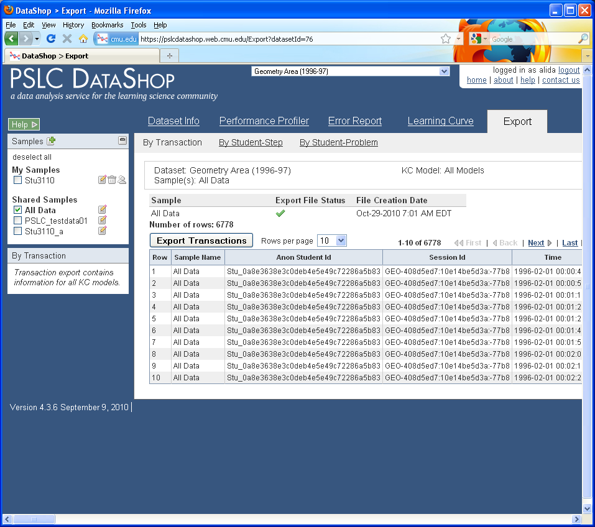
  Export > By transaction
Look for the green check to see if that sample can be exported quickly

Slide 30
PSLC DataShop
datashop-help@lists.andrew.cmu.edu
pslcdatashop.org
Notes:
Be aware that on the transaction export, we try to cache the file ahead of time so that the export is fast. Look at this table to see the status for the sample or samples you are exporting. This does not apply to the student-step and student-problem rollups, only the transaction format.

Slide 31
Places to export
From web services:
  By transaction
  By student-step
Request only some columns
Request only some rows
PSLC DataShop
datashop-help@lists.andrew.cmu.edu
pslcdatashop.org

Slide 32
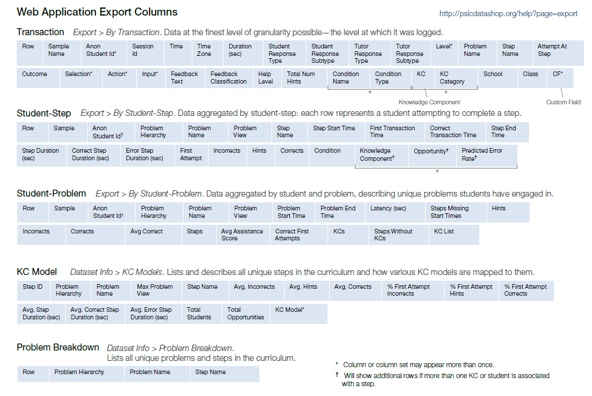
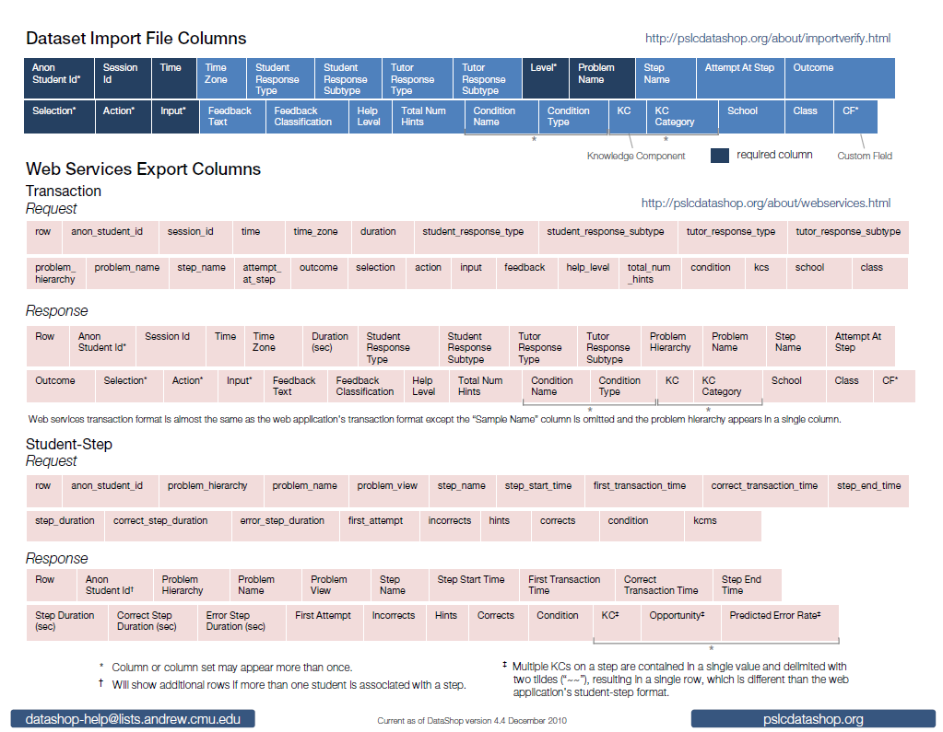
Export columns
Names of columns documented on your cheat sheet:
More extensive documentation available at:
http://pslcdatashop.org/help?page=export
PSLC DataShop
datashop-help@lists.andrew.cmu.edu
pslcdatashop.org
More extensive documentation available at:
http://pslcdatashop.org/help?page=export

Slide 33
Transaction Export Columns
Some columns appear in pairs or sets
  Condition Name and Condition Type
  KC and KC Category
Some columns or column sets can appear more than once
  The above columns
  CF (custom field)
  Level
  Select, Action, and Input
PSLC DataShop
datashop-help@lists.andrew.cmu.edu
pslcdatashop.org

Slide 34
Student-Step Export Columns
Some columns appear in pairs or sets
  KC, Opportunity, Predicted Error Rate
Additional rows for a single step will appear if more than one KC or student is associated with a step
PSLC DataShop
datashop-help@lists.andrew.cmu.edu
pslcdatashop.org

Slide 35
Web Services Export Columns
Differ slightly from the equivalent formats in the web application.
  See cheat sheet for more info
PSLC DataShop
datashop-help@lists.andrew.cmu.edu
pslcdatashop.org

Slide 36
Questions about columns?
PSLC DataShop
datashop-help@lists.andrew.cmu.edu
pslcdatashop.org

Slide 37
Phil Pavlik
Toss it over to

Slide 38
the end

Slide 39
Slides from the introduction to Datashop workshop

Slide 40
Creating an account and Logging in
Getting Started
PSLC DataShop
datashop-help@lists.andrew.cmu.edu
pslcdatashop.org

Slide 41
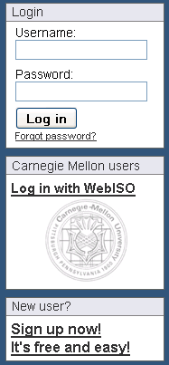
If you are NOT a Carnegie Mellon University student, staff, or faculty member, and have logged in before
If you are a Carnegie Mellon University student, staff, or faculty member
If you are NOT a Carnegie Mellon University student, staff, or faculty member, and have NOT logged in before
PSLC DataShop
datashop-help@lists.andrew.cmu.edu
pslcdatashop.org

Slide 42
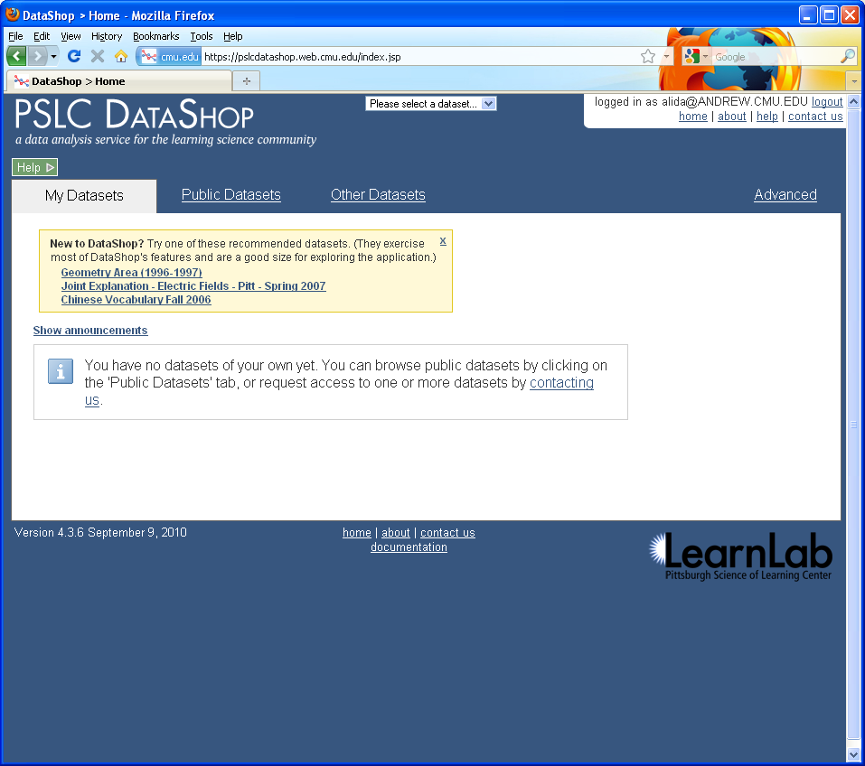

Introduction to PSLC DataShop
December 2010
Notes:
CHECK POINT: Make sure all the participants are on this page.

Slide 43
2
1
There are 3 places to click to get help on how to use DataShop!
3
Introduction to PSLC DataShop
December 2010
Notes:
CHECK POINT: Make sure all the participants are on this page.

Slide 44
1
Click the green help button to get help on the page you are currently on.
PSLC DataShop
datashop-help@lists.andrew.cmu.edu
pslcdatashop.org

Slide 45
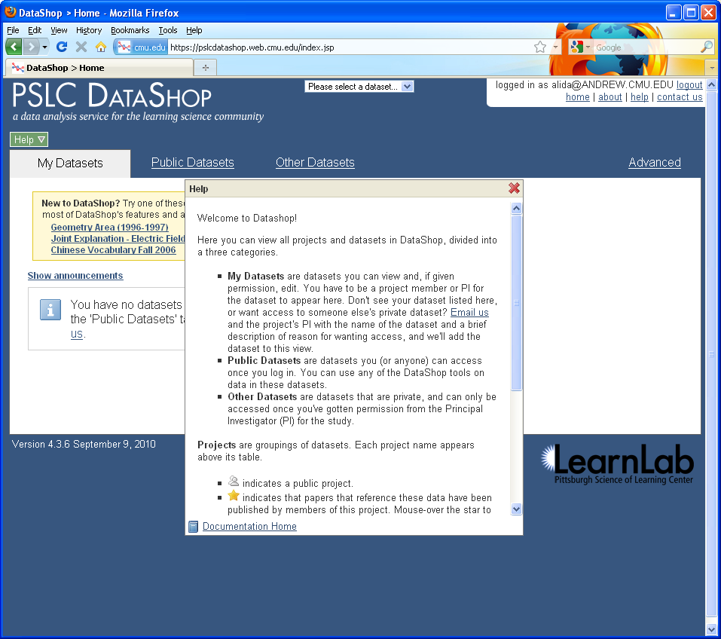
Introduction to PSLC DataShop
December 2010

Slide 46
Click on
‘Documentation Home’ to get more information on this topic in our help pages.
PSLC DataShop
datashop-help@lists.andrew.cmu.edu
pslcdatashop.org

Slide 47
Click ‘about’ to see the latest news about DataShop and to get downloads
Click ‘contact us’ to send us email.
2
Click ‘home’ to get back to a list of projects and datasets in DataShop
Click ‘help’ here to go to the help page for the current report.
PSLC DataShop
datashop-help@lists.andrew.cmu.edu
pslcdatashop.org

Slide 48
3
Click ‘documentation’ at the bottom of any page to go to the help pages.
PSLC DataShop
datashop-help@lists.andrew.cmu.edu
pslcdatashop.org

Slide 49
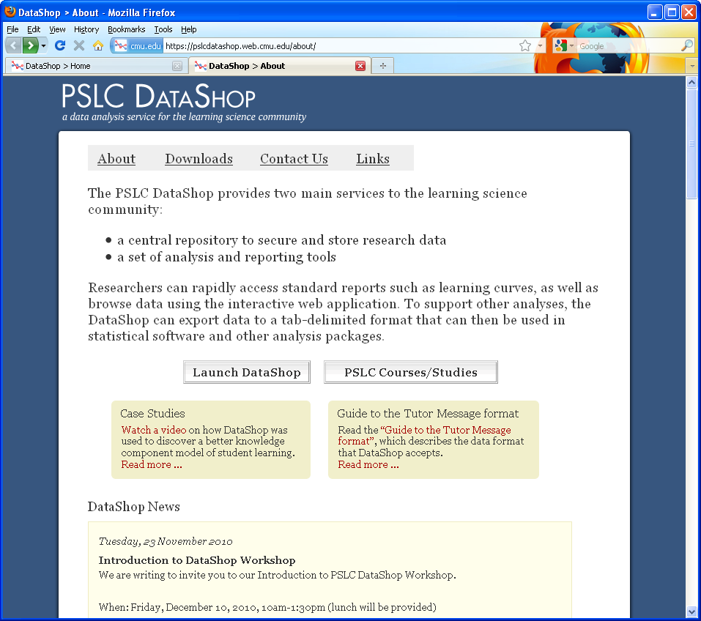
Introduction to PSLC DataShop
December 2010
Notes:
This is our project page where we post news. Its also where you can download the logging library tools, the validation tools, and other downloads.

Slide 50
My Datasets: datasets you can use
Public Datasets: datasets you or anyone can use
Other Datasets: private datasets, you can ask us for access and we’ll confirm with the PI
Recommended Datasets: let’s start with Geometry Area
PSLC DataShop
datashop-help@lists.andrew.cmu.edu
pslcdatashop.org

Slide 51
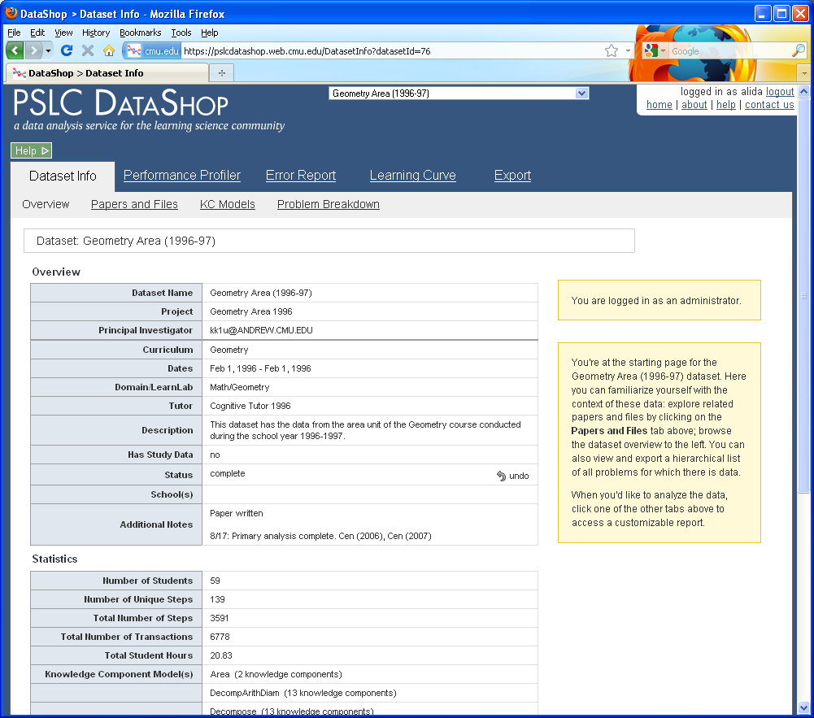
Introduction to PSLC DataShop
December 2010
Notes:
CHECK POINT: Make sure all the participants are on this page.

Slide 52
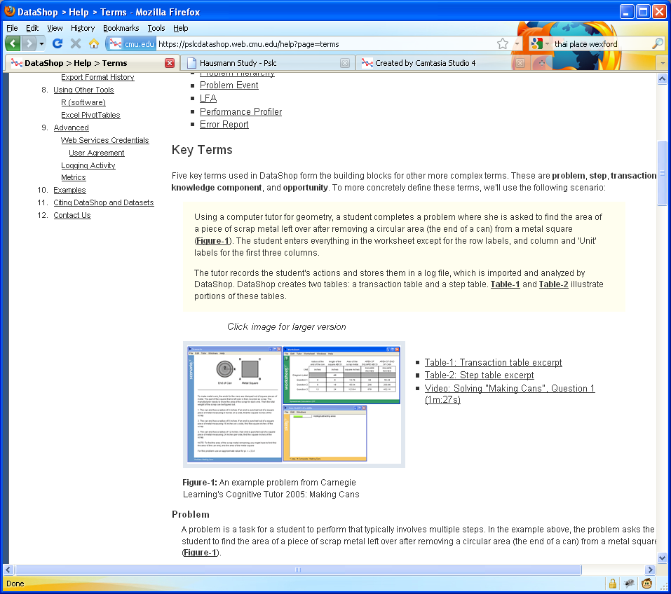
We use the “Making Cans” problem from the Cognitive Tutor as an example to explain the key terms used in DataShop
Watch this video to see how this tutor works

Slide 53
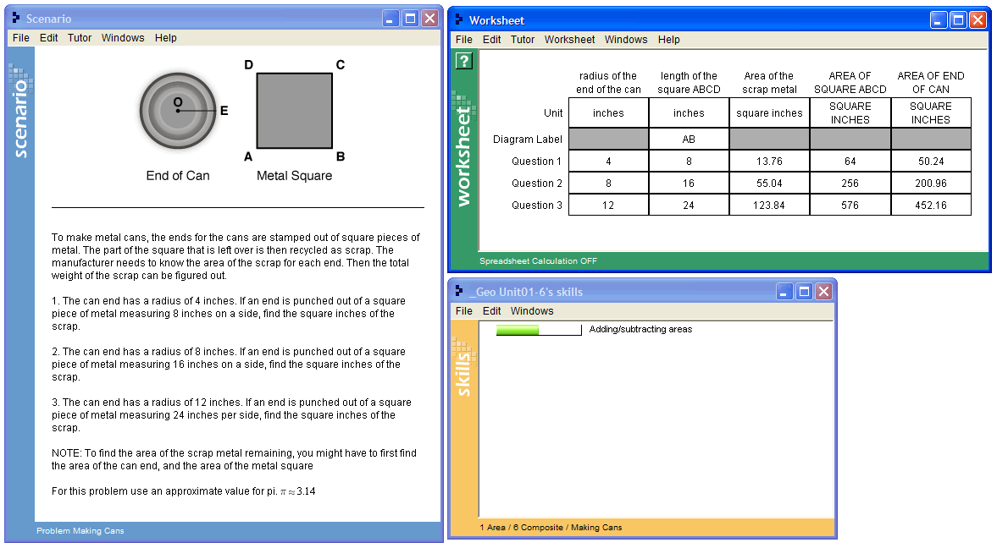
Problem: “Making Cans”
PSLC DataShop
datashop-help@lists.andrew.cmu.edu
pslcdatashop.org

Slide 54
Video: Solving “Making Cans”, Question 1 (1m:27s)
http://pslcdatashop.org/videos/making_cans/making_cans.jsp
PSLC DataShop
datashop-help@lists.andrew.cmu.edu
pslcdatashop.org

Slide 55
Steps
SCRAP-METAL-AREA Q1
SQUARE-BASE Q1
SQUARE-AREA Q1
POG-RADIUS Q1
POG-AREA Q1
PSLC DataShop
datashop-help@lists.andrew.cmu.edu
pslcdatashop.org

Slide 56
Transactions
Row | Student | Problem | Step | Attempt | Input | Evaluation | KC
9 | S01 | MAKING-CANS | (POG-RADIUS Q1) | 1 | 4 | CORRECT | Enter-Given
10 | S01 | MAKING-CANS | (SQUARE-BASE Q1) | 1 | 8 | CORRECT | Enter-Given
11 | S01 | MAKING-CANS | (SCRAP-METAL-AREA Q1) | 1 | 32 | INCORRECT
12 | S01 | MAKING-CANS | (SCRAP-METAL-AREA Q1) | 2 | 4 | INCORRECT
13 | S01 | MAKING-CANS | (SQUARE-AREA Q1) | 1 | 64 | CORRECT | Square-Area
14 | S01 | MAKING-CANS | (POG-AREA Q1) | 1 | 50.24 | CORRECT | Circle-Area
15 | S01 | MAKING-CANS | (SCRAP-METAL-AREA Q1) | 3 | 13.76 | CORRECT | Compose-Areas
PSLC DataShop
datashop-help@lists.andrew.cmu.edu
pslcdatashop.org
Notes:
Define KC and KC Model.

Slide 57
Student-Steps
Row | Student | Problem | Step | Opportunity | Total Incorrects | Total Hints | Assistance Score | Error Rate | KC
6 | S01 | MAKING-CANS | (POG-RADIUS Q1) | 2 | 0 | 0 | 0 | 0 | Enter-Given
7 | S01 | MAKING-CANS | (SQUARE-BASE Q1) | 3 | 0 | 0 | 0 | 0 | Enter-Given
8 | S01 | MAKING-CANS | (SQUARE-AREA Q1) | 1 | 0 | 0 | 0 | 0 | Square-Area
9 | S01 | MAKING-CANS | (POG-AREA Q1) | 2 | 0 | 0 | 0 | 0 | Circle-Area
10 | S01 | MAKING-CANS | (SCRAP-METAL-AREA Q1) | 2 | 2 | 0 | 2 | 1 | Compose-Areas
PSLC DataShop
datashop-help@lists.andrew.cmu.edu
pslcdatashop.org
Notes:
Opportunity relative to KC. A chance for a student to demonstrate that he or she has learned a KC.

Slide 58
Opportunity: a chance for a student to demonstrate that he or she has learned a KC.
Row | Student | Problem | Step | Opportunity | Total Incorrects | Total Hints | Assistance Score | Error Rate | KC
6 | S01 | MAKING-CANS | (POG-RADIUS Q1) | 2 | 0 | 0 | 0 | 0 | Enter-Given
7 | S01 | MAKING-CANS | (SQUARE-BASE Q1) | 3 | 0 | 0 | 0 | 0 | Enter-Given
8 | S01 | MAKING-CANS | (SQUARE-AREA Q1) | 1 | 0 | 0 | 0 | 0 | Square-Area
9 | S01 | MAKING-CANS | (POG-AREA Q1) | 2 | 0 | 0 | 0 | 0 | Circle-Area
10 | S01 | MAKING-CANS | (SCRAP-METAL-AREA Q1) | 2 | 2 | 0 | 2 | 1 | Compose-Areas
PSLC DataShop
datashop-help@lists.andrew.cmu.edu
pslcdatashop.org
Notes:
Opportunity relative to KC. Increases with steps, not with transactions.

Slide 59
Observation: set of transactions for a student working on a step, i.e. each row in this table
Row | Student | Problem | Step | Opportunity | Total Incorrects | Total Hints | Assistance Score | Error Rate | KC
6 | S01 | MAKING-CANS | (POG-RADIUS Q1) | 2 | 0 | 0 | 0 | 0 | Enter-Given
7 | S01 | MAKING-CANS | (SQUARE-BASE Q1) | 3 | 0 | 0 | 0 | 0 | Enter-Given
8 | S01 | MAKING-CANS | (SQUARE-AREA Q1) | 1 | 0 | 0 | 0 | 0 | Square-Area
9 | S01 | MAKING-CANS | (POG-AREA Q1) | 2 | 0 | 0 | 0 | 0 | Circle-Area
10 | S01 | MAKING-CANS | (SCRAP-METAL-AREA Q1) | 2 | 2 | 0 | 2 | 1 | Compose-Areas
PSLC DataShop
datashop-help@lists.andrew.cmu.edu
pslcdatashop.org
Notes:
Each row is an observation

Slide 60
The DataShop Tools
Learning Curve
Sample Selector
Error Report
Performance Profiler
Export
Import
PSLC DataShop
datashop-help@lists.andrew.cmu.edu
pslcdatashop.org

Slide 61
Learning curve
The Tools
How can I visualize student performance over time?
PSLC DataShop
datashop-help@lists.andrew.cmu.edu
pslcdatashop.org

Slide 62
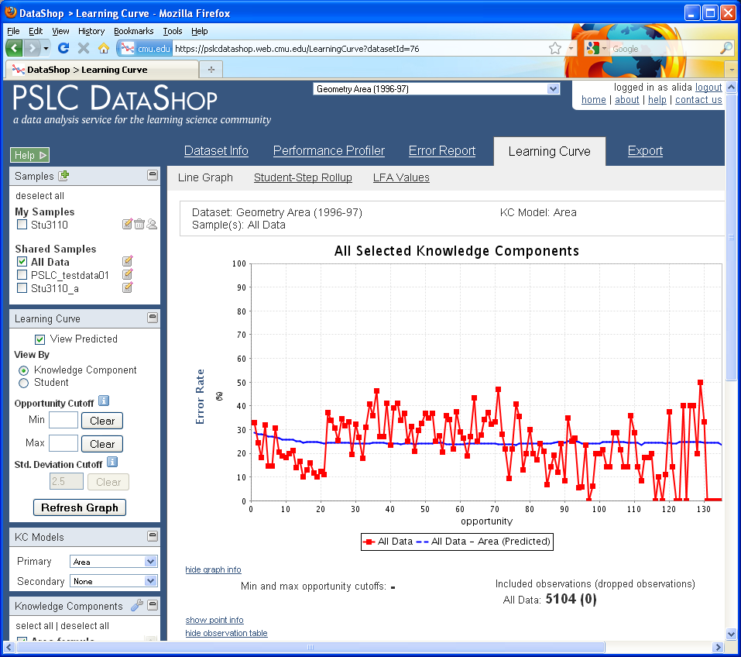

Slide 63
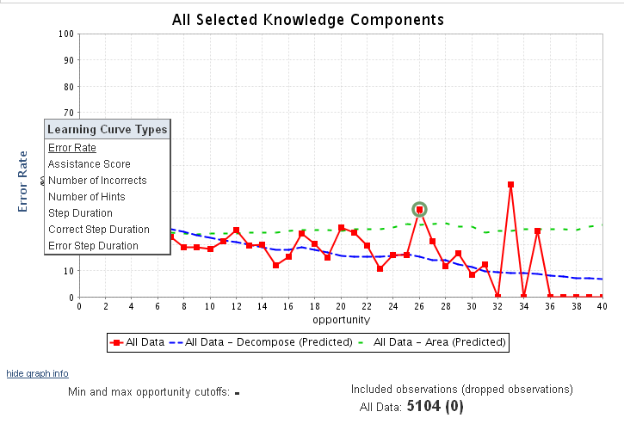
Visualizes changes in student performance over time
Hover the y-axis to change the type of Learning Curve.
Types include:
Error Rate
Assistance Score
Number of Incorrects
Number of Hints
Step Duration
Correct Step Duration
Error Step Duration
Time is represented on the x-axis as ‘opportunity’, or the # of times a student (or students) had an opportunity to demonstrate a KC
PSLC DataShop
datashop-help@lists.andrew.cmu.edu
pslcdatashop.org

Slide 64
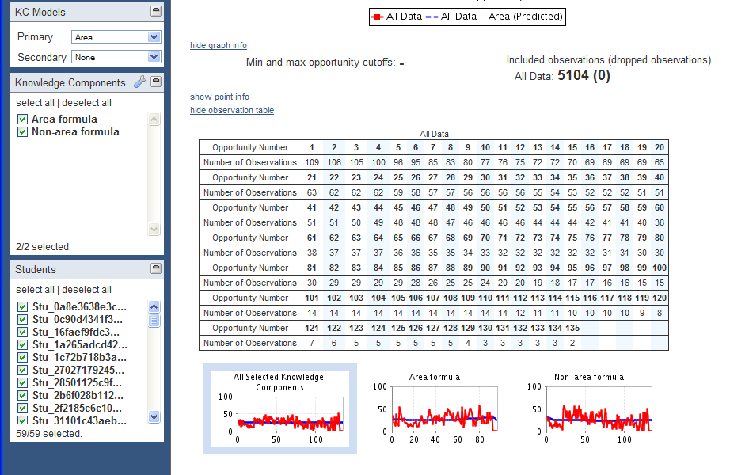
PSLC DataShop
datashop-help@lists.andrew.cmu.edu
pslcdatashop.org
Notes:
Two KCs, lots of practice. Doesn’t show learning of “area formula” or “non-area formula”. This is to say that either a step uses a “Area formula” knowledge component or it uses a “Non-area formula” knowledge component.

Slide 65

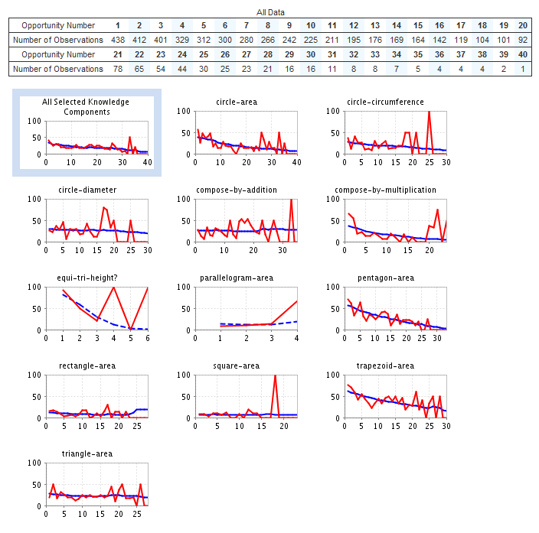
PSLC DataShop
datashop-help@lists.andrew.cmu.edu
pslcdatashop.org

Slide 66
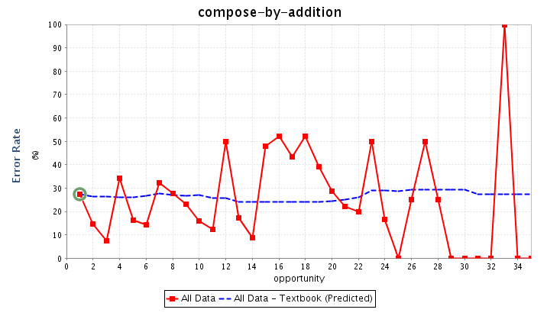
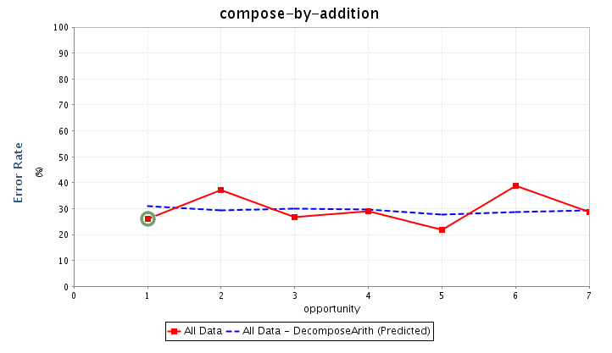
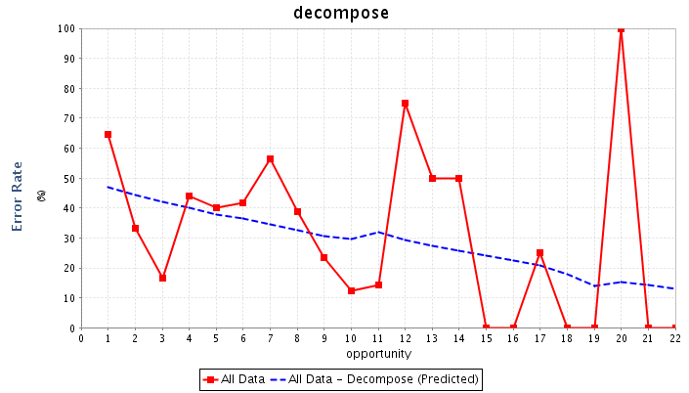
PSLC DataShop
datashop-help@lists.andrew.cmu.edu
pslcdatashop.org
Notes:
Plenty examples of not smooth curves. In this particular dataset, work was done to analyze the user interface of the tutor and the data, and come up with a different KC model.
So, why is this useful? Why care whether you can make smoother curves?

Slide 67
If you change the KC model,
you should consider changing instruction
Problem creation, selection, and sequencing
  New skills or concepts (new KCs) require:
    New kinds problems & instructional activities
    Changes to student modeling – skillometer, knowledge tracing
Feedback and hint message content
  One KC becomes two => need new hint messages for new KC
  New error feedback may be needed
Even interface design – “make thinking visible”
  If multiple KC per step => break down by adding new intermediate steps to interface
PSLC DataShop
datashop-help@lists.andrew.cmu.edu
pslcdatashop.org
Notes:
Can’t do this IN DataShop, but worth considering the implications.

Slide 68
If interested in KC modeling …
Related tools
  Model Values (Learning Curve > Model Values)
  KC Models (Dataset Info > KC Models)
… but most tools in DataShop benefit from having a reasonable KC model.
PSLC DataShop
datashop-help@lists.andrew.cmu.edu
pslcdatashop.org

Slide 69
Sample selector
The Tools
PSLC DataShop
datashop-help@lists.andrew.cmu.edu
pslcdatashop.org

Slide 70
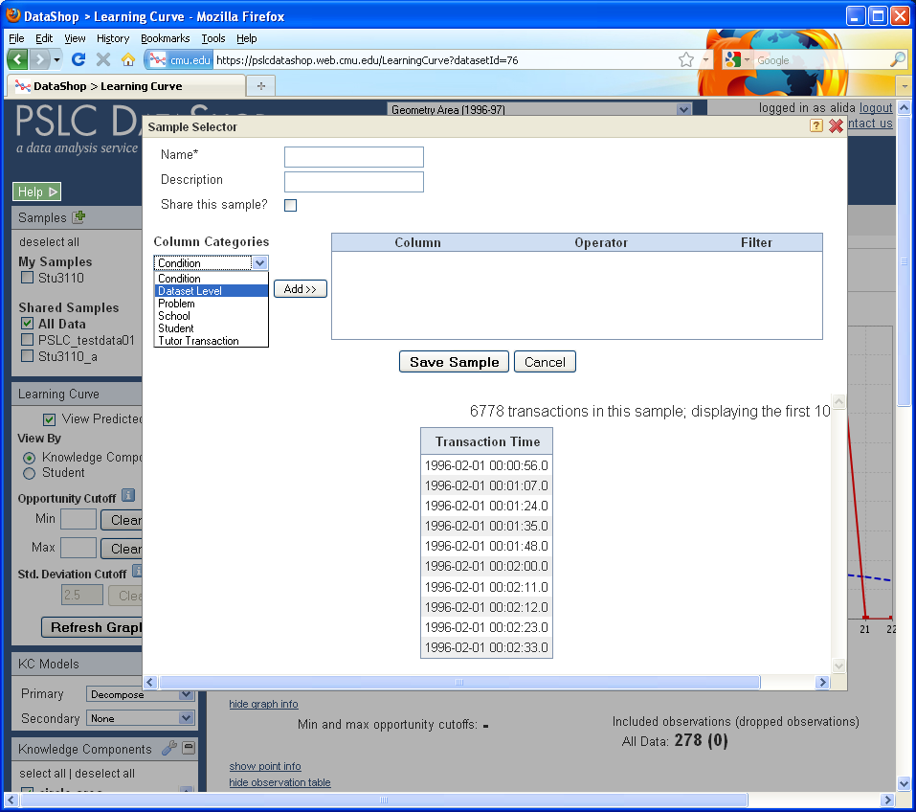

Slide 71
Sample Selector
Not samples in the statistical sense—these are subsets of data
You can make your own
  e.g., filter on condition if that’s encoded in the data
You can switch between them, or show more than one sample
Notes:
e.g., on learning curve shows line per sample.

Slide 72
Performance profiler
The Tools
What was the hardest problem for students? How many students worked in a particular unit?
PSLC DataShop
datashop-help@lists.andrew.cmu.edu
pslcdatashop.org

Slide 73
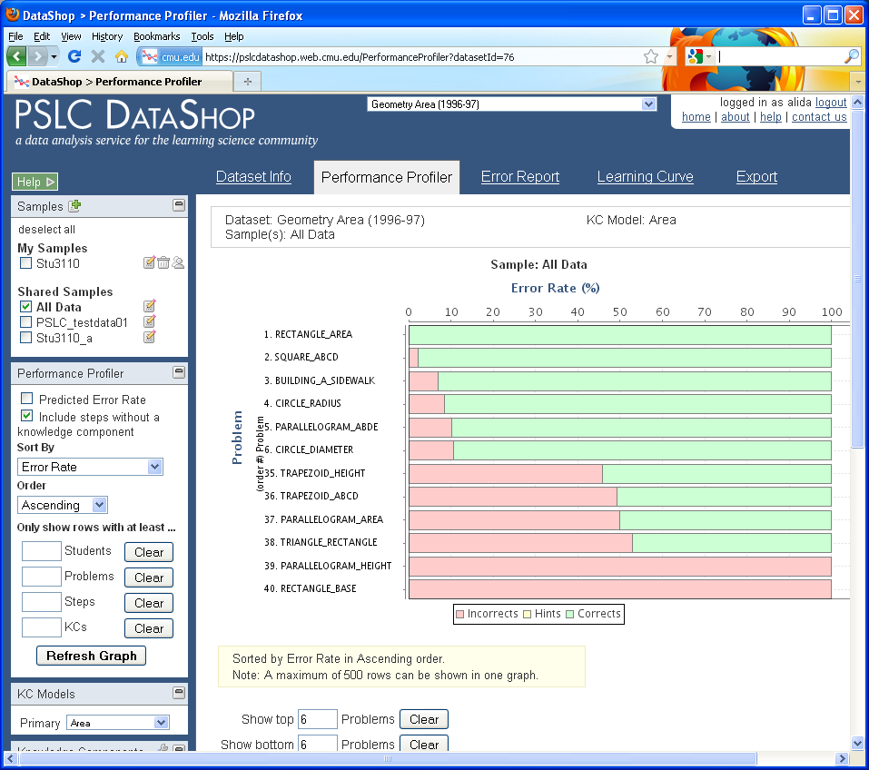

Slide 74
Change the settings for this tool using the options on the left hand side of the page
Change the sort order here
Set a minimum number of students to filter out problems not seen by many students
PSLC DataShop
datashop-help@lists.andrew.cmu.edu
pslcdatashop.org

Slide 75
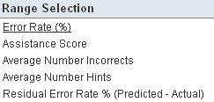
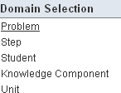
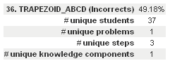
Change how the selected measure is aggregated by hovering the title for the x-axis.
Change the selected measure by hovering the title for the y-axis.
See more details by hovering a bar in the graph.
PSLC DataShop
datashop-help@lists.andrew.cmu.edu
pslcdatashop.org

Slide 76
Error report
The Tools
How can I explore the errors students made and drill down to see actual responses and feedback?
PSLC DataShop
datashop-help@lists.andrew.cmu.edu
pslcdatashop.org

Slide 77
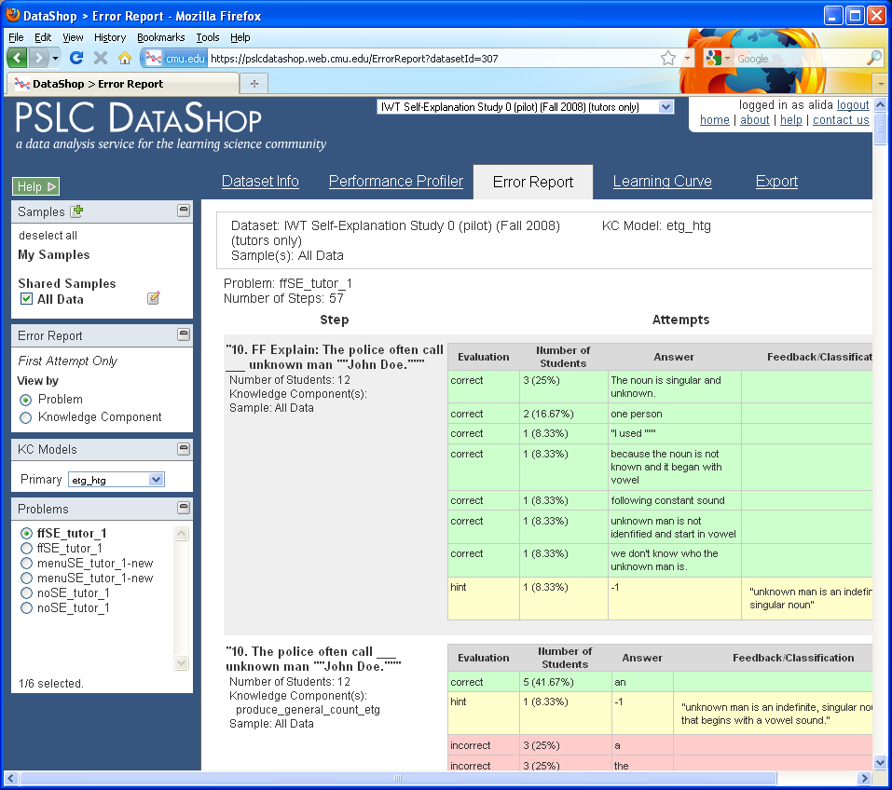
Notes:
Switch to IWT Self-Explanation Study 0 (pilot) (Fall 2008)

Slide 78
Change the settings for this tool using the options on the left hand side of the page
PSLC DataShop
datashop-help@lists.andrew.cmu.edu
pslcdatashop.org

Slide 79
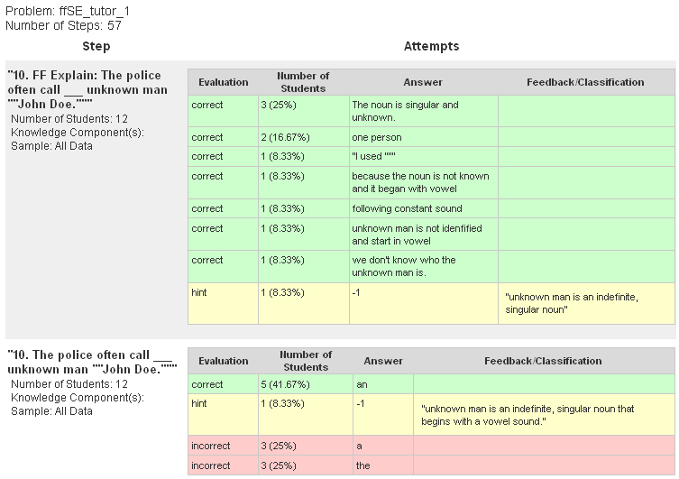
The number of observations by type (correct, hint, or incorrect)
Details what the student actual typed into the tutor
PSLC DataShop
datashop-help@lists.andrew.cmu.edu
pslcdatashop.org
Notes:
Find a common error in English article usage

Slide 80
Export
The Tools
How do I get my data out of DataShop?
PSLC DataShop
datashop-help@lists.andrew.cmu.edu
pslcdatashop.org

Slide 81
IMPORT
The Tools
How do I get my data into DataShop?
PSLC DataShop
datashop-help@lists.andrew.cmu.edu
pslcdatashop.org

Slide 82
How do I get data in?
Directly/Real-time
  Some tutors are logging directly to the PSLC logging database
  CTAT-based tutors (when configured correctly), can log to disk or to the logging database over the internet
Indirectly
  Other tutors are logging to their own file formats or their own databases
    These data require a conversion process
    Many studies are in this category
PSLC DataShop
datashop-help@lists.andrew.cmu.edu
pslcdatashop.org
Notes:
Directly refers to real-time logging of data. In this situation, a tutor that is instrumented to log to DataShop sends its data over the web to a logging database. With a system like CTAT, this capability is built in.
Indirect logging—you might be storing data in your own format on your own hard disk or server. In this case, you’d need to consider how to convert your data from your format to DataShop’s.

Slide 83
XML vs. Tab-delimited format
XML
Richer description than tab-delimited
  More fields
  Problem start time
  Problem description
  Problem tutor flag
More verbose
Requires some familiarity with XML
Not especially readable
Tab-delimited
More concise
Can edit in Excel
More easily shareable
Less rich than XML
  Missing problem start time, description, and tutor flag
PSLC DataShop
datashop-help@lists.andrew.cmu.edu
pslcdatashop.org
Notes:
DataShop has two similar formats, XML and tab-delimited. Tab-delimited is tabular, like an Excel spreadsheet. XML, if you’re not familiar, is like HTML; it’s a way of marking up, or describing, text; except with XML, those descriptions correspond to our format.
So how do they differ? Tab-delimited is generally simpler; why not just choose that format?
XML is richer. You have access to more fields, one of the most important being “problem start time”—you can say exactly when something was presented to a student or user. If you’re doing any type of latency-based analysis, this information might be crucial. Right now, it’s only available in the XML format.
XML, however, is more verbose—more lines of text to describe roughly the same thing—and its usually generated by a program.
Why tab-delimited? It’s more concise, editable in Excel, more human-readable. But it’s less rich.

Slide 84
Documentation
For XML:
Guide to the Tutor Message Format:
http://pslcdatashop.org/dtd/guide/
For tab-delimited format:
http://pslcdatashop.org/about/importverify.html
To learn about terminology:
http://pslcdatashop.org/help?page=terms
To learn about existing DataShop output formats:
http://pslcdatashop.org/help?page=export
PSLC DataShop
datashop-help@lists.andrew.cmu.edu
pslcdatashop.org
Notes:
Here are some documentation pointers. I won’t say more about this; this information is in your copy of the slides.

Slide 85
Web services
The Tools
How can I programmatically retrieve data from DataShop?
PSLC DataShop
datashop-help@lists.andrew.cmu.edu
pslcdatashop.org

Slide 86
Web Services
Enable your program or web site to retrieve DataShop data
  teacher reports
  data mining
  other analysis through code
PSLC DataShop
datashop-help@lists.andrew.cmu.edu
pslcdatashop.org
Notes:
Are you developing a program or web application that could benefit from retrieving DataShop data? Some examples might be teacher reports, data mining or analysis through a programming language… this is an advanced feature that we wanted to mention for future reference.

Slide 87
Dataset Info
The Tools
PSLC DataShop
datashop-help@lists.andrew.cmu.edu
pslcdatashop.org

Slide 88
Go to the ‘Papers and Files’ subtab to download or attach papers and files to the given dataset.
Go to the ‘KC Models’ subtab to view, compare, export and/or import KC Models.
Go to the ‘Problem Breakdown’ subtab to view and export a complete list of steps.
PSLC DataShop
datashop-help@lists.andrew.cmu.edu
pslcdatashop.org

Slide 89
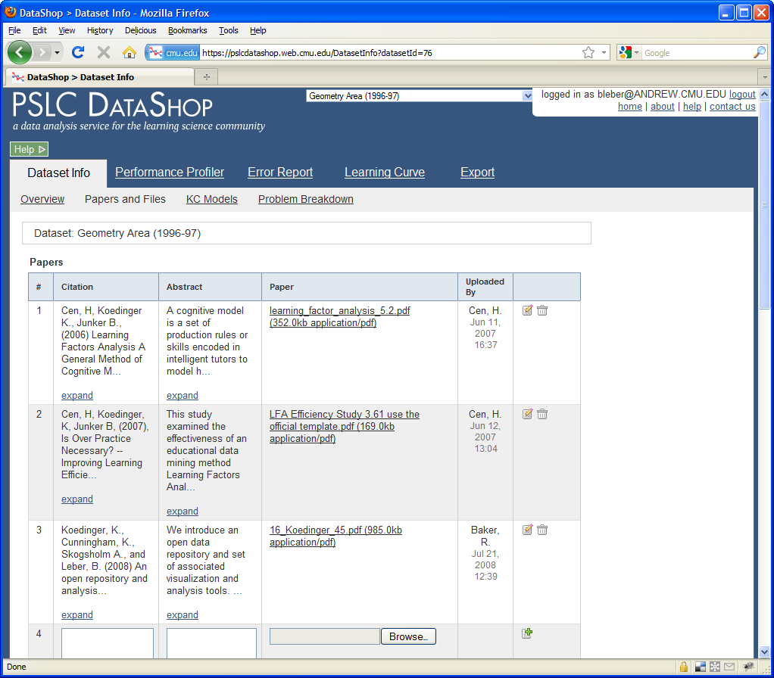

Slide 90
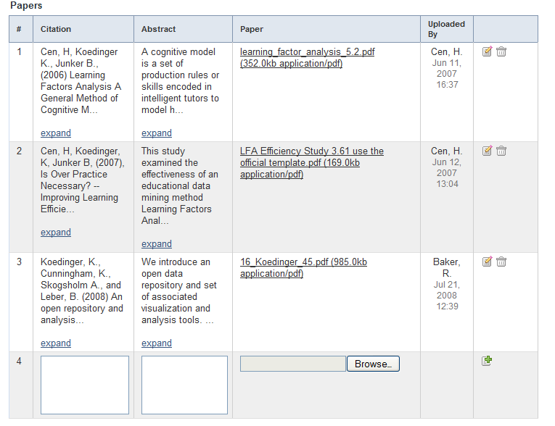
Download file
Attach related papers
PSLC DataShop
datashop-help@lists.andrew.cmu.edu
pslcdatashop.org

Slide 91
KC Models
The Tools
PSLC DataShop
datashop-help@lists.andrew.cmu.edu
pslcdatashop.org

Slide 92
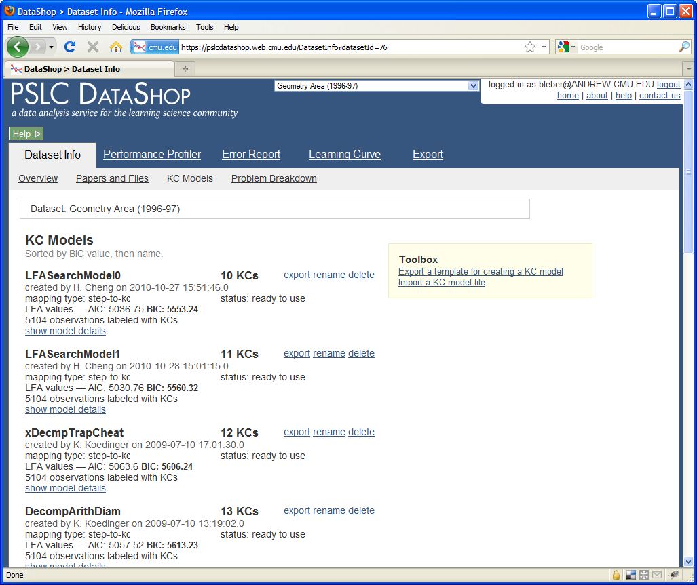

Slide 93
Compare the BIC values across models
Click on these links to export and Import KC Models
PSLC DataShop
datashop-help@lists.andrew.cmu.edu
pslcdatashop.org

